Slide 1
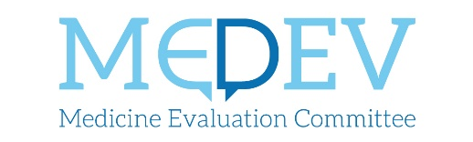
Trends in pharmaceutical expenditure New report
3rd ESIP Annual Forum
Brussels, 15 October 2024

Slide 2
Trends in pharma expenditure
Scope
Is national public expenditure for medicines on the rise?
Methodology
Latest trends in pharmaceutical expenditure and comparison with previous years
Drivers of pharmaceutical expenditure (prices, volumes, therapeutic areas)
16 respondents (15 EU MSs + Norway)
Limitations
Different parameters for data collection
Net VS list prices
In and/or out-patient care
Different reference years
Notes:
Context:
Increasing prices and limited data on therapeutic advantages (conundrum high prices-low evidence)
Industrial policies for health
Limitations: the scope for data collection (in- and/or out-patient care; net or list prices) is clarified in each country fiche.

Slide 3

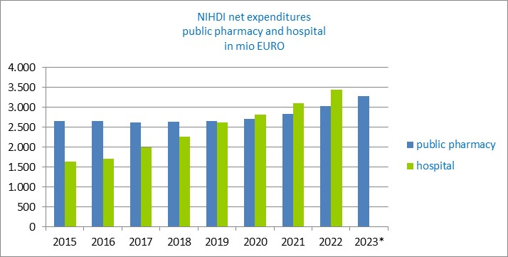


We spend more for medicines
Steady increase in both in-patient & out-patient care
Even with cost-containment mechanisms, net expenditure is increasing
Notes:
[In-patient and out-patient combined]
First finding: We spend more on medicines. All respondents observed a generalised and steady increase, both for in-patient and out-patient care.
Belgium:
The statistic includes both hospital and community pharmacy expenditure and refer to net costs. It shows an increase in pharma expenditure in both sectors with growth rates reaching 8.2% in 2023. Hospital expenditure [in green] in particular has grown consistently: expenditure for hospitals more than doubled since 2015, moving from 1.5 billion EUR to almost 3.5 billion in 2022.
Portugal:
The statistic includes once again both hospital and community pharmacy expenditure and this time refer to list prices. The total pharmaceutical expenditure increased from 2.2 billion EUR in 2014 to 3.6 billion EUR in 2023. The greatest yearly increase in percentage of + 10,9% was recorded between 2021 and 2022, but pharmaceutical expenditure keeps increasing steadily with a growth rate of + 6.7% from 2022 to 2023. Here again, pharmaceutical expenditures are higher for the in-patient sector and growing at a faster rate [green].
France:
The statistic compares hospital and community pharmacy expenditure. It shows the differential growth rate between list prices [blue line] and net costs [green line]. While in 2023 pharma expenditures amounted to 38.5 billion EUR in list prices, the net pharmaceutical expenditure amounted to 28.6 billion EUR. The growth rate varies from +8.5% for list prices to +2.8% for net costs. This means that, despite successful cost-containment measures, net expenditure is also increasing. This is true even during the pandemic years, where expenditure on pharmaceuticals is considered to have decreased. Instead, the average annual net expenditure growth stands at 2.8%, while it was 0.4% before COVID-19.

Slide 4

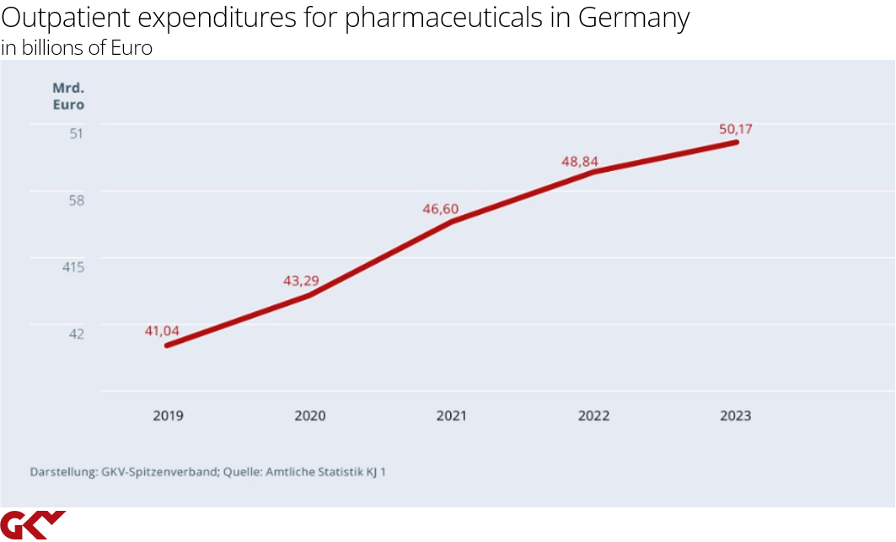

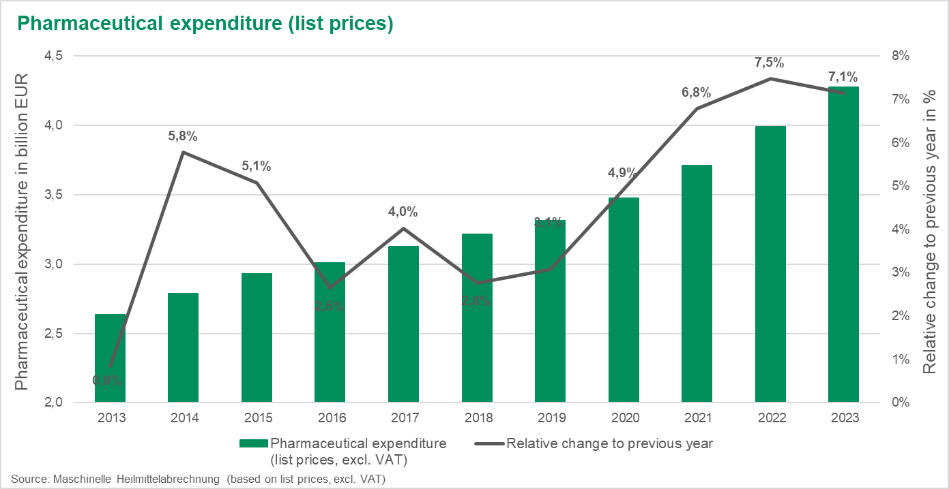
We spend more for medicines
Steady increase in out-patient care
The actual expenditure increase sometimes even exceeds the increase forecast in national annual budgets
Notes:
[Out-patient only]
First finding: We spend more on medicines. All respondents observed a generalised and steady increase, both for in-patient and out-patient care.
Germany:
The statistics refers to community pharmacy, net expenditure. The figure is straightforward: Net out-patient pharmaceutical expenditure amounted to 50.17 billion EUR in 2023 compared to 48.84 billion EUR in 2022, corresponding to an increase of 2.72 %. Since 2019 there was an increase of about 9 billion EUR in total.
Austria:
The statistic refers to community pharmacy expenditure, this time for list prices excluding VAT and individual rebates. In the last 10 years, out-patient pharmaceutical expenditure increased by 1.6 billion EUR, with an average annual growth rate of 7.1% between 2021-2023, compared to 3.6% in the three previous years (2018-2020). The black line in the statistic indicated the interannual growth rate variation and marks a steep increase since 2019.

Slide 5
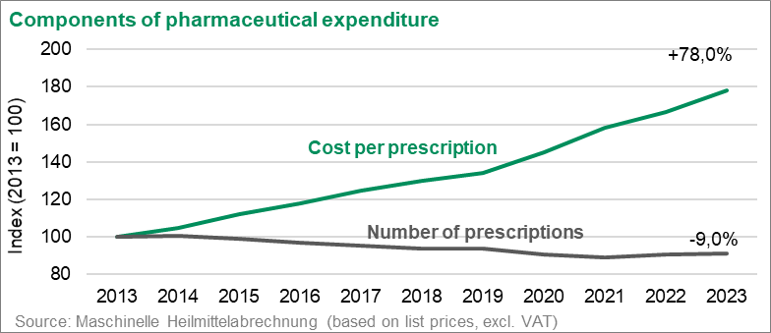
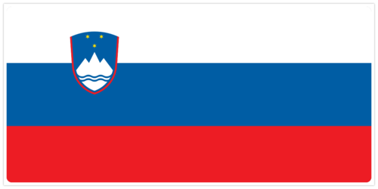
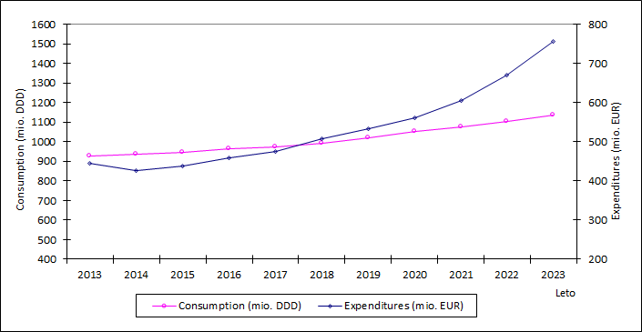
Drivers of pharma expenditure
Higher prices
Increase in prices rather than volume of reimbursed medicines
Linked to the rising share of novel expensive drugs on the overall pharmaceutical expenditure
Notes:
Second finding: the main driver of the overall pharmaceutical expenditure is higher prices rather than increased volumes (numbers of prescriptions). Particularly, the introduction of novel expensive therapies has led the increase of pharmaceutical expenditure.
Austria:
Looking at the two components of out-patient pharmaceutical expenditure (cost per prescription and number of prescriptions), the driver for pharmaceutical expenditure since 2013 is a growing price level (average cost per prescription: +78.0%), while volume slightly declined (number of prescriptions: -9.0%).
Slovenia:
The total expenditure on medicines in Slovenia (in-patient and out-patient combined) reached 725.2 million EUR in 2023. Expenditure for prescription drugs [blue line] in particular has been surging in recent years, from 2014 onwards, while the consumption curve [pink line] grows rather steadily. Between 2014 and 2023, the average annual growth rate of all public medicine expenditure (including those paid to hospitals separately) was +6.6 %.

Slide 6
Expensive therapeutic areas
Concentration of expenditure in oncology medicines, including orphan indications, both for in- & out-patient care
Out-patient sector
In-patient sector
Notes:
Third finding: some expensive and profitable therapeutic areas drive the increase in pharmaceutical expenditure. Respondents reported a concentration of expenditure in oncology medicines, including orphan indications, for both the in- and out-patient care sector.
France:
Out-patient sector: On average, spending in all therapeutic areas increased after Covid (2020-2023), with growth rates ranging between 4% and 15% per year, compared to an average of 1.3% per year before Covid (2017-20). Oncology accounts for 29% of out-patient expenditures. With an average annual growth of 11% over 2017-23, oncology has contributed to more than half of out-patient expenditure growth. Other therapeutic areas that are drivers of pharmaceutical expenditure increase are blood and hematopoietic organs (driven by anticoagulants and antihemorrhagics) with +11%/year over 2020-23, and respiratory system (driven by recent treatments in cystic fibrosis) with +15%/year over 2020-23.
In-patient sector: hospital drugs account for 22% of the of the overall pharmaceutical expenditure. Oncology accounts for 77% of in-patient expenditure. Reimbursements increased by 23% in 2023 and contributed to 87% of total in-patient growth.
For all respondents, other therapeutic areas of significant and increasing expenditure are immunology, metabolic diseases and diabetology (growing costs of antidiabetic drugs), hematology (increase in sales of novel anticoagulants), cardiovascular diseases (especially in the out-patient sector).

Slide 7
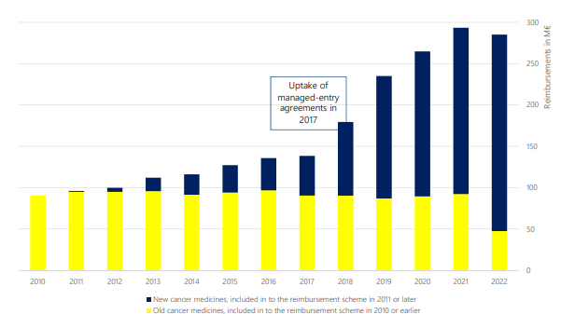

New expensive products take up the lion’s share
Notes:
Third finding: some expensive and profitable therapeutic areas drive the increase in pharmaceutical expenditure. Respondents reported a concentration of expenditure in oncology medicines, including orphan indications, for both the in- and out-patient care sector.
Finland:
The expenditure increase in the domain of oncology could be associated with the shifts towards novel expensive drugs. This is the case for Finland, where cancer medicines accounted for 16% of total pharmaceutical reimbursement in 2022. In the statistic, the blue bar indicates new cancer medicines, while the yellow bar refers to well-established cancer medicines.

Slide 8
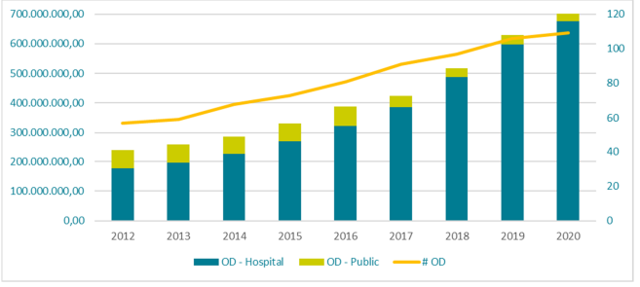
In the field of rare diseases
Faster expenditure growth on orphan medicines
Notes:
Fourth finding: pharmaceutical expenditure is increasing at a faster pace in the realm of rare diseases.
Belgium:
A consistent increase in the net annual expenditure for OMPs was recorded since 2012. Orphan pharmaceutical expenditure has nearly doubled from around 300 million EUR in 2012 to over 600 million EUR by 2020 [yellow line], while the number of ODs available for reimbursement also increased. There is therefore a clear correlation between the increasing number of OMPs and the rising expenditure.
France:
The statistic shows the average annual growth rate of orphan drugs compared to the global drug market. Orphan expenditure has almost doubled since 2019, with an average annual growth rate standing at +20.4% over the 2019-22 period compared to +3.4% for non-orphan drugs. The share of orphan expenditure in the total pharmaceutical expenditure in 2022 stood at 7.4% (net prices), compared to 4.7% in 2019.
Overall, respondents reported an increasingly greater share of orphan expenditure in the total pharma expenditure, with interannual growth rates higher than in the global drug market. Significant costs are associated to former orphan drugs (which lost orphan status).
The fastest growing therapeutic area is oncology.

Slide 9
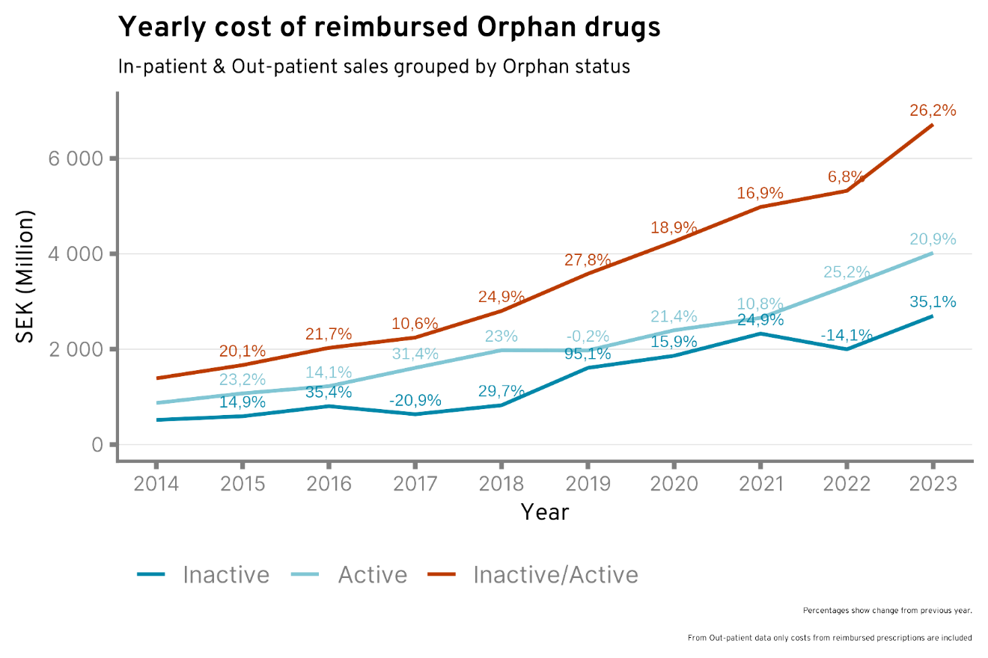
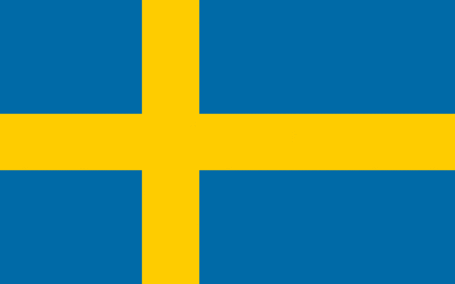
In the field of rare diseases
Faster expenditure growth on orphan medicines
Notes:
Fourth finding: pharmaceutical expenditure is increasing at a faster pace in the realm of rare diseases.
Sweden:
Orphan pharmaceutical expenditure is surging in recent years. The interannual growth rate was particularly high from 2022 to 2023 and reached +26.2%, exceeding 6 billion SEK in expenditure. The previous variation between 2021 and 2022 stood at +6.8%. This growth trend includes both ‘active’ orphan drugs [light blue line] and ‘inactive’ (former) orphan drugs [dark blue line]. For the latter, increase in expenditure was higher and reached +35.1% in 2023.
Overall, respondents reported an increasingly greater share of orphan expenditure in the total pharma expenditure, with interannual growth rates higher than in the global drug market. Significant costs are associated to former orphan drugs (which lost orphan status).
The fastest growing therapeutic area is oncology.

Slide 10
Thank you for your attention!
Any questions?

